Slide 1
Covid-19 Vaccine Adverse Reaction Prediction using VAERS Dataset
Prepared by Zhi Jun

Slide 2
Content
Introduction
Objective
Data understanding
Data cleaning
Visualization
Data preprocessing
Model building
Model results
Future work

Slide 3
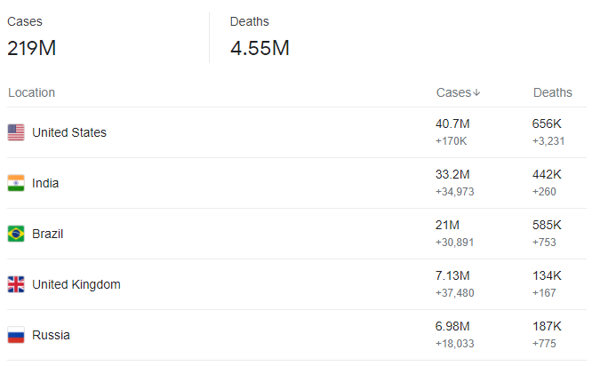
Introduction
Start from 2020, Covid-19 is begin to spread around the world, with more than 220 million confirmed cases and 4.5 million deaths across almost 200 countries.
Luckily nowadays, have few vaccine for the covid-19 have been released.
But based on the research, most of the vaccine have adverse reaction, even have threat recipient life.

Slide 4
Objective
To identify different vaccine, current illness, symptom after vaccination will threat recipient life or not.
Build the model let user to key in their info to detect they have life threat after vaccine.

Slide 5
Data Understanding
Data set is take from Kaggle COVID-19 Vaccine Adverse Reactions (VAERS).
Details in dataset includes Covid-19 vaccine symptoms, Age, Gender, Recovery Status, Death, Vaccine Manufacturer, and many more information.
The Vaccine Adverse Event Reporting System (VAERS) is a United States program for vaccine safety, co-managed by the U.S. Centers for Disease Control and Prevention (CDC) and the Food and Drug Administration (FDA).
The timeline for this dataset is from Jan 2021 to July 2021.

Slide 6
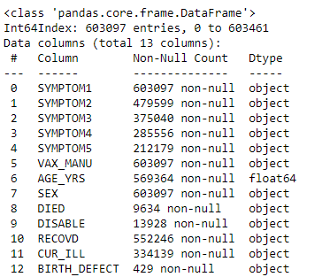
Data Understanding
Total have 52 feature in this data set. But only 13 feature will be use.
12 of the features are object type and only Age for the recipient is float type.

Slide 7
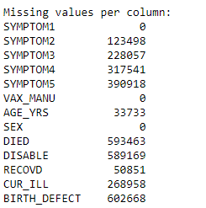
Missing value
Only symptom 1, Vaccine manufacture, and sex is no missing value.
For Symptom 2 to 5, since some of the recipient wouldn’t have more than 1 symptom, so the have missing value is normal.
For column Age, will drop the missing value and categories to 5 stage, Child, teen, adult, middle age adult, and senior adult.
For column DIED, DISABLE, CUR_ILL and BIRTH_DEFECT will replace missing value to “n”. RECOVD will replace to “u”.

Slide 8
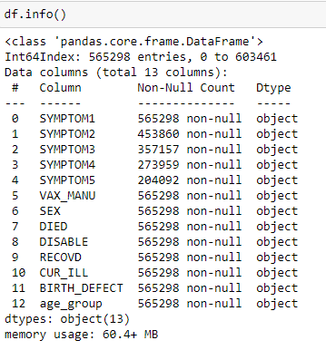
After Cleaning
After clean the data, we only have 565,298 rows and 13 columns.

Slide 9
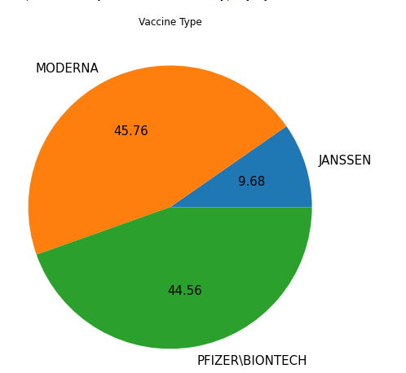
Data visualization
Have 45.76% is Moderna, 44.56% is Pfizer, and only 9.68% is Janssen.

Slide 10
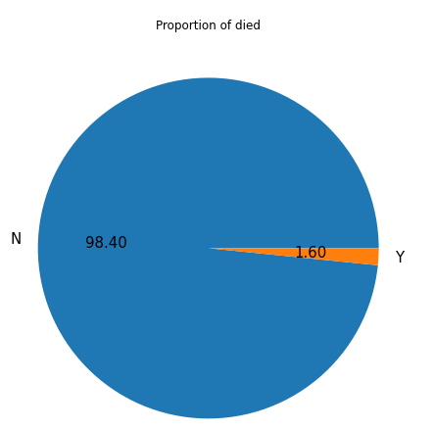
Proportion of “DIED”
Only 1.6% will died after vaccination.
Since the “DIED” column is target variable, the data will imbalaced.

Slide 11
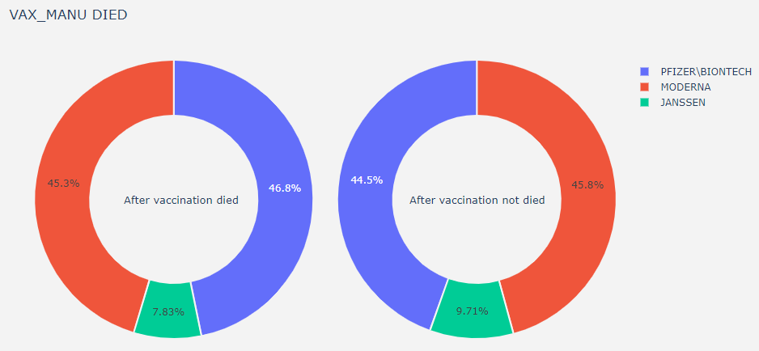
Vaccine type Against DIED
The proportion of the both pie chart is similar to the pie chart of vaccine type.

Slide 12
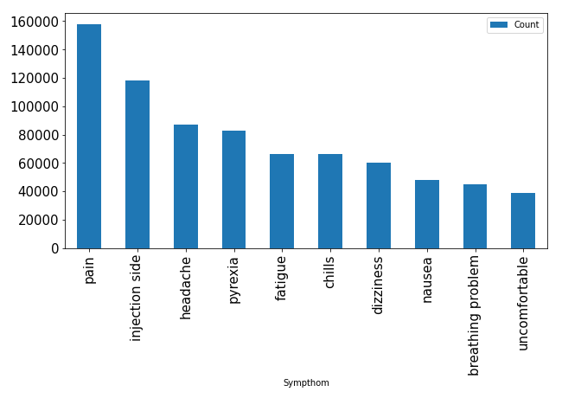
The most frequent symptom after vaccine
The top 5 most frequency symptom are pain, injection side, headache, pyrexia and fatigue.
These 5 symptoms will be feature in model development part.

Slide 13
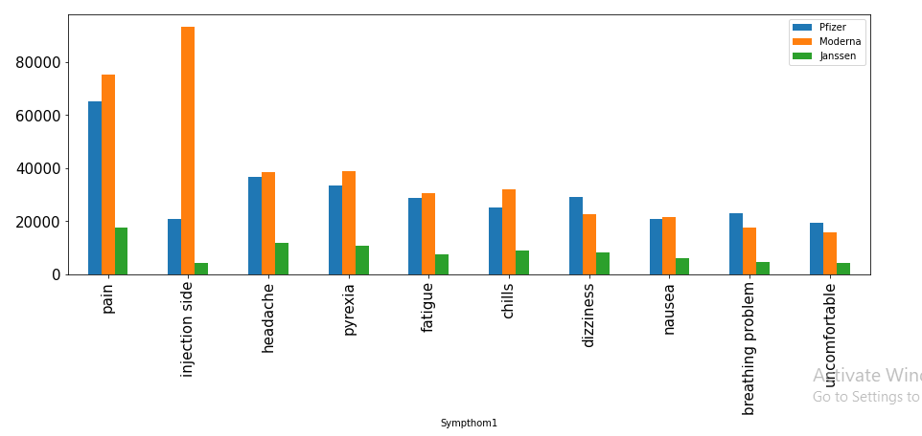
Top Frequent Symptom VS VAX_MANU
The Moderna vaccine have more proportion for the injection side vaccine.

Slide 14
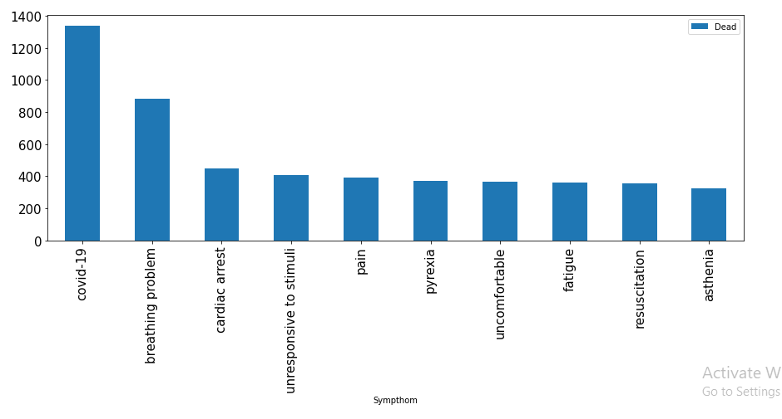
Symptom VS Died
The top 5 frequency symptom will threat the life of recipient are covid-19, breathing problem, cardiac arrest, unresponsive to stimuli, and pain.
Since the 5th &6th symptom already choose on previous, the uncomfortable will be feature for model part.

Slide 15
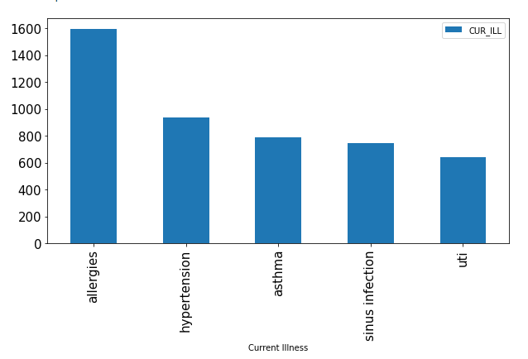
Current illness VS died
The top 5 frequency current illness will threat the life of recipient are allergies, hypertension, asthma, sinus infection and uti.
These 5 symptoms will be feature in model development part.

Slide 16
Data Preprocesing
label encoder
SEX
DIED
DISABLE
BIRTH_DEFECT
dummy variable for multi category
VAX_MANU
RECOVD
AGE_GROUP
dummy variable for symptom
Headache
Pain
Pyrexia
Injection side affect
Fatigue
Covid-19
Breathing problem
Cardiac arrest
Unresponsive to stimuli
Uncomfortable
dummy variable for current illness
Covid-19
Hypertension
UTI
Diabetes
Lactose Intolerance

Slide 17
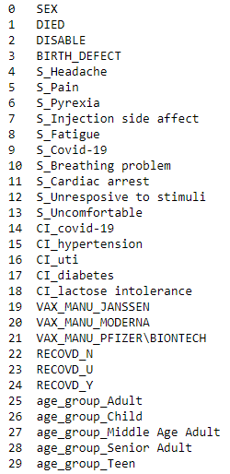
Data Preprocessing
After transform, total have 30 columns.
The target variable is DIED column, others will be feature.

Slide 18
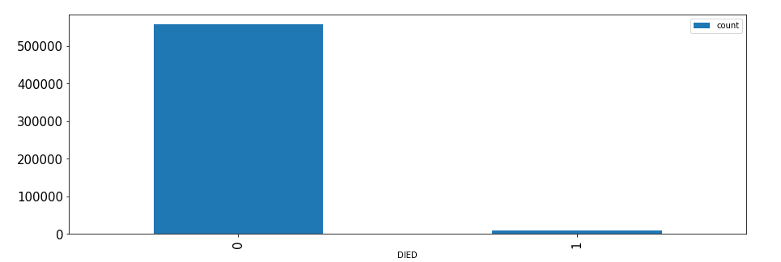

Data Imbalanced

Slide 19
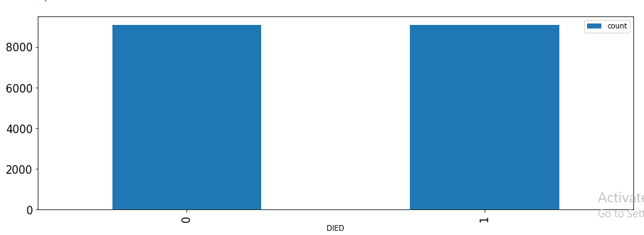

Resampling the data

Slide 20
Data Set
70%
30%
Train Set
Test set

Slide 21
ML Algorithm
Logistic regression
Decision tree
Random forest
Naïve Bayes
Support vector machine(SVM)
Artificial Neural Network (ANN)

Slide 22
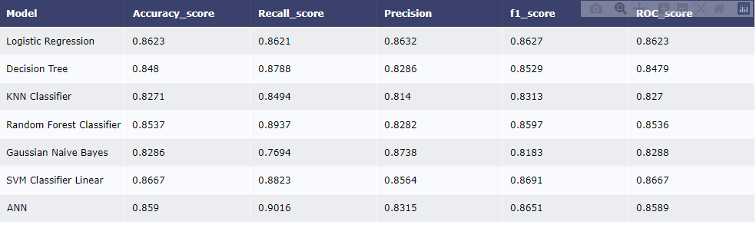
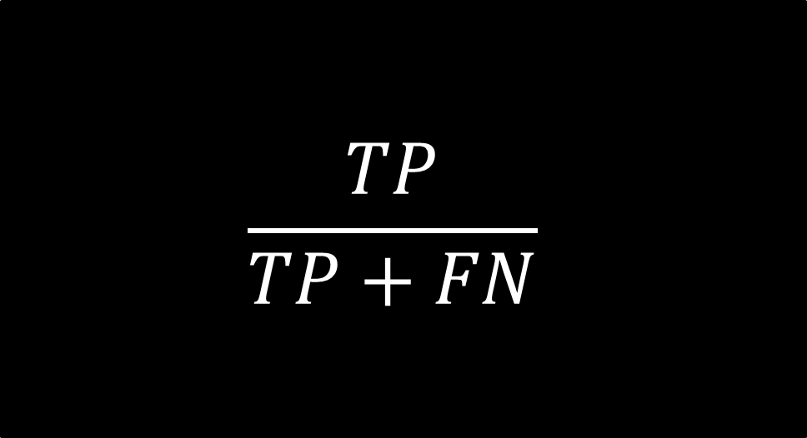
The ANN model be choose to be final model.
The recall score is higher.
The recall score is calculated how many predicted are correctly.
$$\frac{TP}{TP+FN}$$

Slide 23
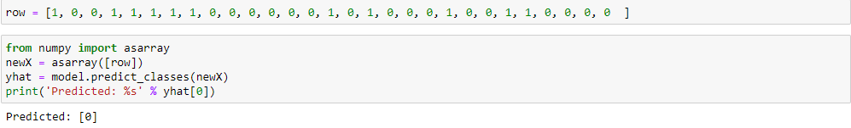
Use model to predict life threat
Male
Adult
Vaccine: Pfizer
Recovered Status: Yes
Current Illness: Hypertension, Diabetes
Symptom: Headahce, Pyrexia, Injection side affect

Slide 24
Conclusion
This project is aim to design the model to let user to key in information to like gender, age, adverse reaction (symptom), current illness to predict they have life threat or not after vaccine.
In future work, will design the model to let user key in the which vaccine they were take and some information to predict the symptom.
Involve other type of vaccine and other country data.

Slide 25
Thank you

